Slide 1



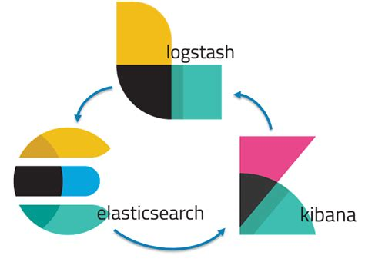





RED TEAM
Summary of Operations
John Burnham
ASU Cybersecurity Bootcamp

Slide 2


Table of Contents
Network Topology
Exposed Services
Critical Vulnerabilities
Exploitation

Slide 3
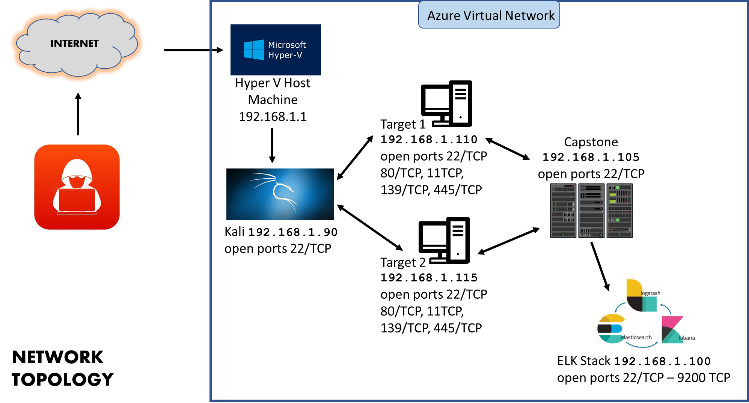

Slide 4
Exposed Services
The Red Team scan identifies the services below as potential ports to exploit:
Target 1
Port 22/tcp - ssh
Port 80/tcp - http
Port 111/tcp - rbcbind
Port 139/tcp - netbios-ssn
Port 445/tcp - netbios-ssn

Slide 5
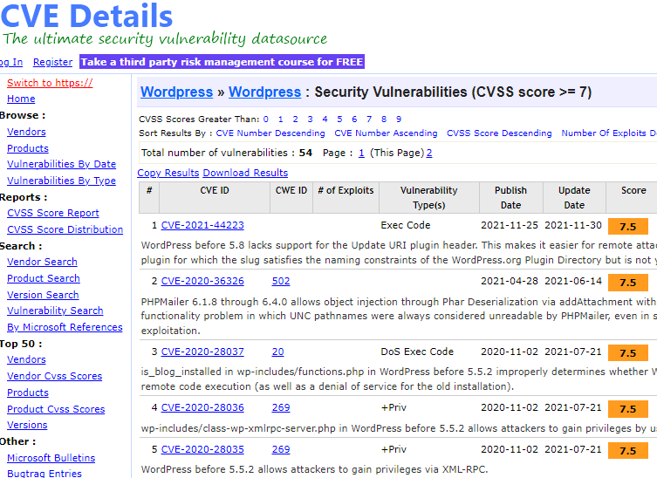
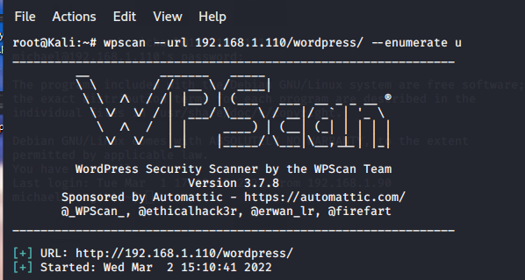
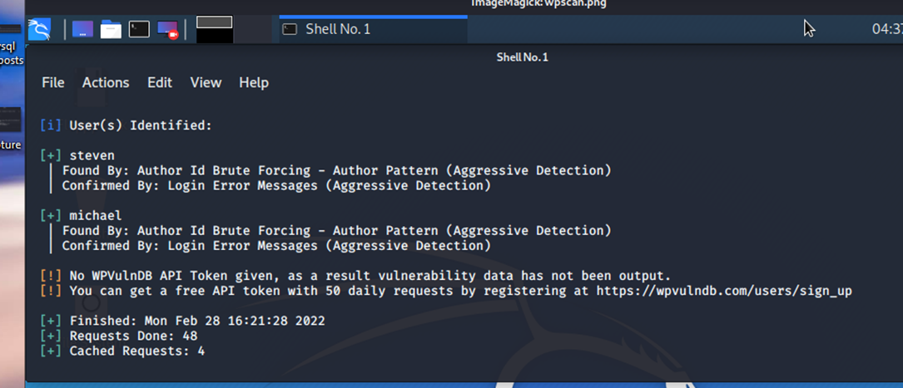
Critical
Vulnerabilities
The Raven Security website was running WordPress which is know for exploitation on certain versions. Running a wpscan revealed two usernames:
Michael and Steven.

Slide 6
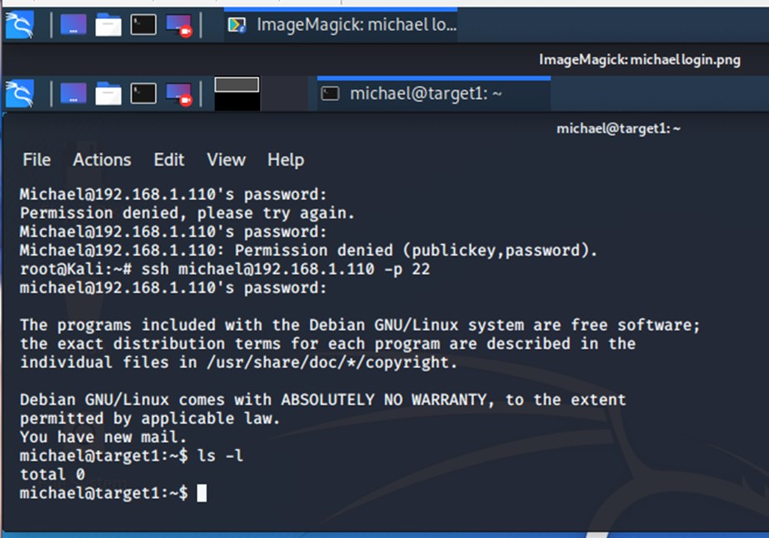
Exploitation
After discovering the usernames from the wpscan, an attempt to access the system by simply trying Michael’s name as the password allowed access into the system through the open ssh port 20.

Slide 7
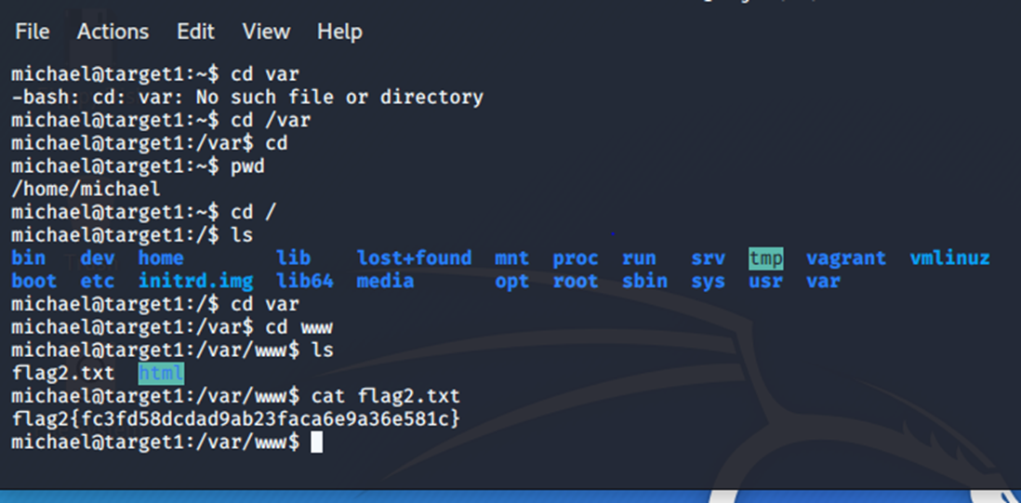
Exploitation
Using Michael’ credentials to obtain entry into the user shell, flag 2 can be found by listing the files and directories in the /var/www/ and then displaying the contents with cat.
:/var/www$ cat flag.txt

Slide 8
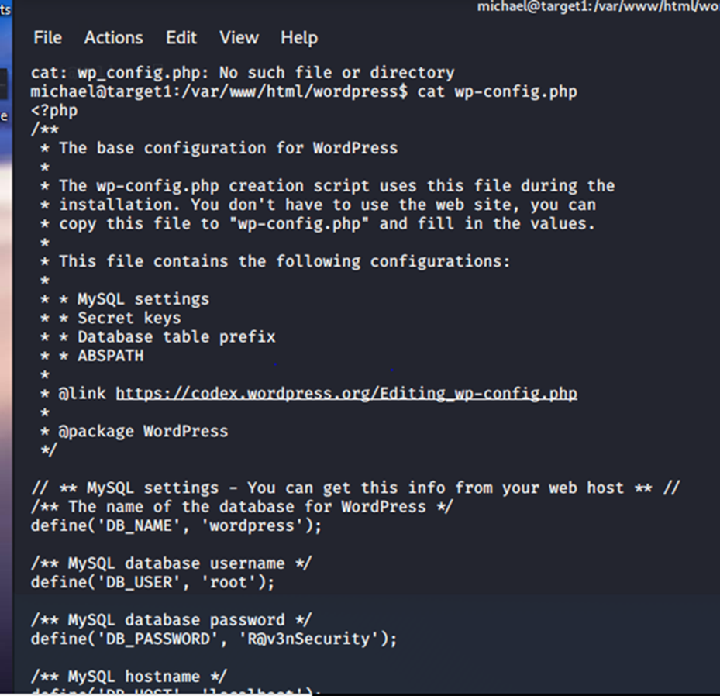
Exploitation
:/var/www/wordpress$ cat wp_config.php
In the /var/www/html/ wordpress/ directory, the wp_config.php file contained the credentials for gaining access to the MySQL database – which may expose more flags and/or hashes.
MySQL pw: R@v3nSecurity

Slide 9
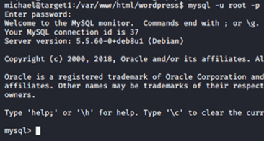
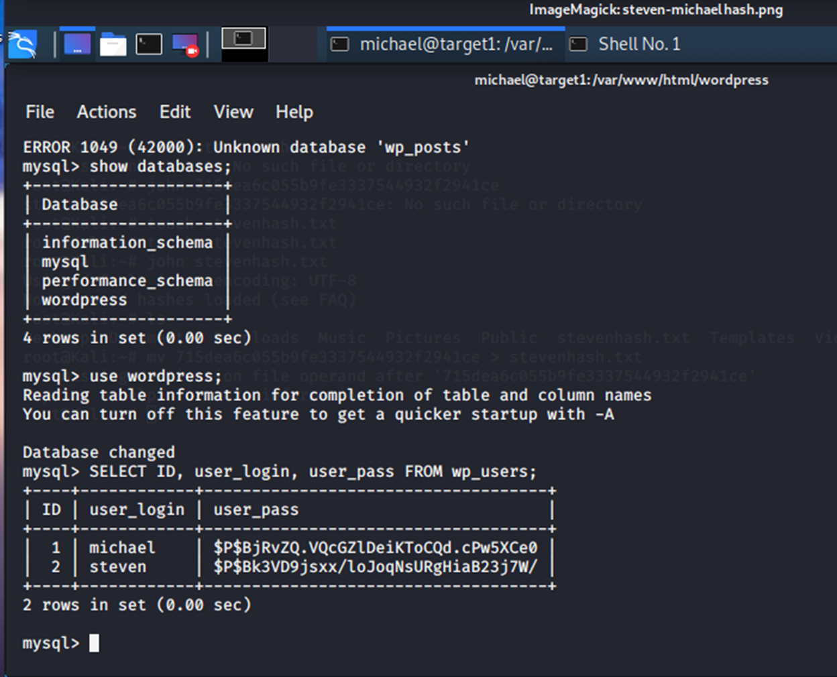
Exploitation
:/var/www/wordpress$ mysql –u root -p
msql> SELECT ID, user_login, user_pass, FROM wp_users;
Once in the MySQL Wordpress database, both Michael and Steven’s usernames and password hash’s can be found by selecting users and passwords from the wp_users file.

Slide 10
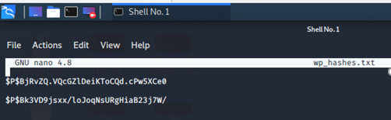
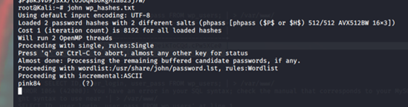
Exploitation
Now that username hash’s have been found, John the Ripper can be used to find the actual passwords. A file, wp_hashes.txt, is created in a text editor for the JtR hash ripping.
:nano wp_hashes.txt
# john wp_hashes.txt
John the Ripper found the password, pink84, which must be Steven’s because we already know Michael’s pw (michael).

Slide 11
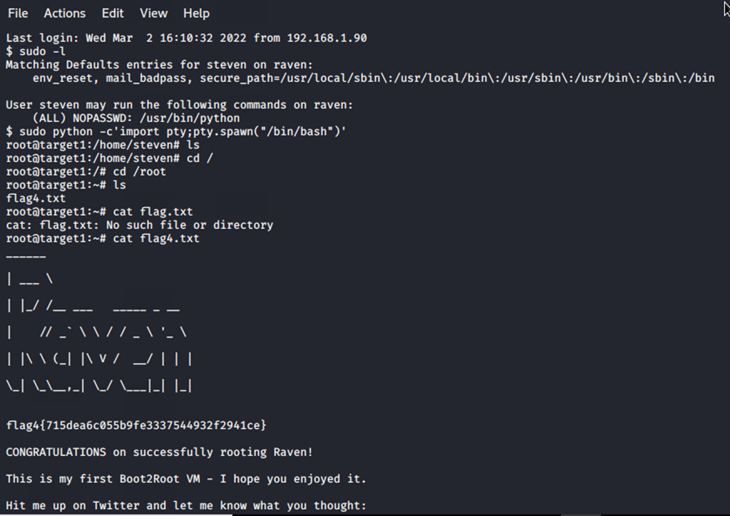
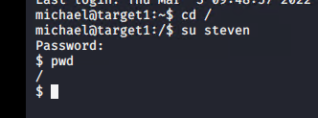
Exploitation
A python command could be exploited with Steven’s sudo privileges gaining full system control in a spawn shell and discover the final flag..
$ su steven
With Steven’s password it was possible to gain root privilege.
:sudo python –c’import pty;pty.spawn(“bin/bash”)’

Slide 12

Flag 1 b9bbcb33e11b80be759c4e844862482d
Flag 2 fc3fd58dcdad9ab23faca6e9a36e581c
Flag 3 afc01ab56b50591e7dccf93122770cd2
Flag 4 715dea6c055b9fe3337544932f2941ce

Slide 13







Azure Virtual Network
INTERNET
Hyper V Host Machine
192.168.1.1
Target 1 192.168.1.110
open ports 22/TCP
80/TCP, 11TCP, 139/TCP, 445/TCP
Capstone 192.168.1.105
open ports 22/TCP
Kali 192.168.1.90
open ports 22/TCP
Target 2 192.168.1.115
open ports 22/TCP
80/TCP, 11TCP, 139/TCP, 445/TCP
NETWORK
TOPOLOGY
ELK Stack 192.168.1.100
open ports 22/TCP – 9200 TCP

